Slide 1
Kubernetes Fundamentals – Part 1
WorkshopPlus – Kubernetes Tech Briefing

Slide 2
Conditions and terms of use
© Microsoft Corporation. All rights reserved.
You may use these training materials solely for your personal internal reference and non-commercial purposes. You may not distribute, transmit, resell or otherwise make these training materials available to any other person or party without express permission from Microsoft Corporation. URL’s or other internet website references in the training materials may change without notice. Unless otherwise noted, any companies, organizations, domain names, e-mail addresses, people, places and events depicted in the training materials are for illustration only and are fictitious. No real association is intended or inferred. THESE TRAINING MATERIALS ARE PROVIDED “AS IS”; MICROSOFT MAKES NO WARRANTIES, EXPRESS OR IMPLIED IN THESE TRAINING MATERIALS¹

Slide 3

Topics
 | What is Kubernetes?
 | Cluster Components
 | Basic Kubernetes Objects

Slide 4
What is Kubernetes

Slide 5
What is Kubernetes?
Microsoft investing in Kubernetes
Portable
Public, private, hybrid, multi-cloud
88%
of enterprises using or adopting Kubernetes
Extensible
Modular, pluggable, hookable, composable
74% of enterprises that use Kubernetes are running workloads in production
74% of survey respondents have a DevSecOps initiative underway
At least 20% of enterprises that use Kubernetes leverage six different open-source security tools
Self-healing
Auto-placement, auto-restart, auto-replication, auto-scaling
Notes:
Talk about why Kubernetes is used, what problems it solves and some of the scaling difficulties that took place before an orchestrator like it was developed.
Kubernetes is a portable, extensible, open-source platform for managing containerized workloads and services, that facilitates both declarative configuration and automation.
The name Kubernetes originates from Greek, meaning helmsman or pilot.
K8s as an abbreviation results from counting the eight letters between the "K" and the "s".
Google open-sourced the Kubernetes project in 2014. Donated to Cloud Native Computing Foundation (CNCF) in 2015
Microsoft’s Brendan Burns was a co-creator!
There are more container orchestration available: Docker Swarm, Service Fabric, Mirantis

Slide 6
What’s behind the growth?
It’s widely used
It’s vendor-neutral
It’s community-supported
Kubernetes is in production for global companies across industries¹
A variety of cloud providers
offer robust Kubernetes support
There’s a huge community of active contributors supporting Kubernetes³
Capital
One
eBay
SAP
Azure
AWS
35,000
contributors since 2016
1.1 million
contributions since 2016
New York Times
Pokémon Go
Spotify
VMWare
Red Hat

Slide 7
Cluster Components

Slide 8
Cluster Components
Agent pools
Agent node
User
kubelet
kube-proxy
Internet
Control Plane: manages the agent nodes and the pods in the cluster
    api-server: front end of the Kubernetes control plane; exposes Kubernetes API
    controller-manager: runs the controller processes
    scheduler: tracks newly created pods and selects node to run them on
    etcd: stores the state of the cluster (config, running workloads status, etc.)
  Agent nodes: run your application workloads
    Pods: a collection of containers co-located on a single machine
    kube-proxy: a network proxy that runs on each node in a cluster
    kubelet: agent that runs on each node in a cluster; ensures containers are running in a pod
    Runtime: software responsible for running containers. Includes WASM, containerd and CRI-O
Control plane
Container runtime
api-server
Pods
Pods
Containers
Containers
controller-manager
scheduler
Agent node
kubelet
kube-proxy
Internet
replication, namespace, serviceaccounts, etc.
etcd
Container runtime
Pods
Pods
Containers
Containers
Notes:
Control Plane
API Server - Exposes the Kubernetes API outside the cluster.
etcd - Consistent and highly-available key value store used to store for all cluster data.
Scheduler - Watches for newly created Pods with no assigned node and selects a node for them to run on.
Controller Manager - Manages controller processes
Cloud-controller-manager: cloud-specific control logic, linking clusters into the cloud providers API
Example controllers: Node controller, Job controller, Replication controller, Namespace controller, Endpoint controller, Service Account controller, etc.
Controller pattern: watch the state of the cluster, then make or request changes where needed.
Worker Node
Kubelet - Makes sure that containers are running in a Pod. It takes ensures that the containers described in Pod Specs are running and healthy.
Kube-proxy - Maintains the network rules, which allow network communication to your Pods from network sessions inside or outside of your cluster.
Container runtime - Kubernetes supports several container runtimes, including containerd and CRI-O

Slide 9
Basic Kubernetes Objects

Slide 10


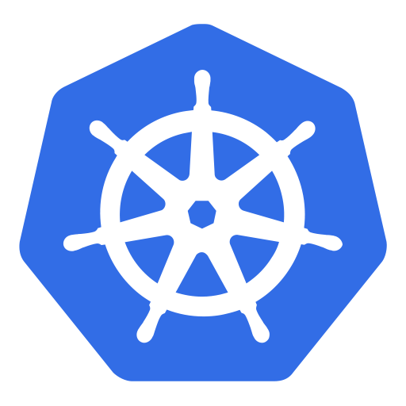
Overview of basic Kubernetes resources
Cluster
Cluster – A collection of machines networked together.
Node – A single machine (physical or VM) in a cluster.
Pod – A wrapper around one or more Containers. A Pod is scheduled on a Node.
Container – A single containerized application instance, based on an image, managed by a Pod.
Volume – A connection to external storage outside the Pod.
Service – A network configuration directing traffic to a Pod.
ConfigMap/Secret – An external configuration that can be referenced by multiple Pods.
Namespaces: a way to logically segment a cluster
Namespace
Namespace
Node
Pod
Pod
Container
Container
Container
Volume
Volume
Node
Pod
Pod
Container
Container
Container
Volume
Service
Service
ConfigMap
ConfigMap
Secret
Secret

Slide 11

Pods
In Kubernetes, you never directly run a container, instead you run a Pod.
A Pod is a “wrapper” around one or more containers.
Pod
Storage
Spec
Pod environment
Container
Container
localhost
Networking Namespace
IP Address
10.0.1.1
Port Space
Notes:
A Pod is the smallest deployable compute units you can create and manage in Kubernetes.
A Pod can manage one or more containers, with shared storage (volumes) and network resources, and a specification for how to run the containers.
Containers running in a Pod share the same IP and ports and communicate using native inter-process communication channels or localhost.
Pods are immutable - if any change is made to the Pod specification (spec), a new Pod is created and then the old Pod is deleted.
Talk about scaling limitations of pods

Slide 12
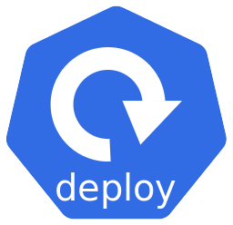
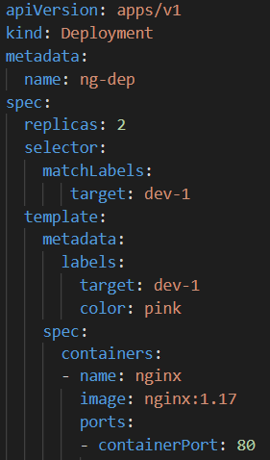
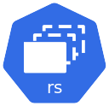
Deployments
A Deployment is a higher-level controller that manages ReplicaSets and provides declarative updates to Pods along with a lot of other useful features.
You describe a desired state in a Deployment, and the Deployment Controller changes the actual state to the desired state at a controlled rate.
Deployments provide fine-grained control over how and when a new pod version is rolled out as well as rolled back to a previous state
Notes:
Briefly mention replica sets and how the deployment uses that object, but emphasize the main workload deployment method is deployments

Slide 13
Deployment at Work
Let’s say we are running a deployment with 2 replicas of a pod. For illustration, our deployment is designated with a yellow background.
Developer makes the change to the deployment image tag and to sets the background to green
The Deployment creates a ReplicaSet v2, which will create 2 new Pods with the updated image.
Once the new Pods are up and running, the Pods attached to ReplicaSet v1 are deleted.
Deployment
ReplicaSet v1
REPLICA COUNT 0
ReplicaSet v1
REPLICA COUNT 2
ReplicaSet v2
REPLICA COUNT 2
Pod
Pod
Pod
Pod
Containers
Containers
Containers
Containers
containerd
containerd
Worker node 1
Worker node 2
NOTE: Notice that ReplicaSet v1 remains.

Slide 14

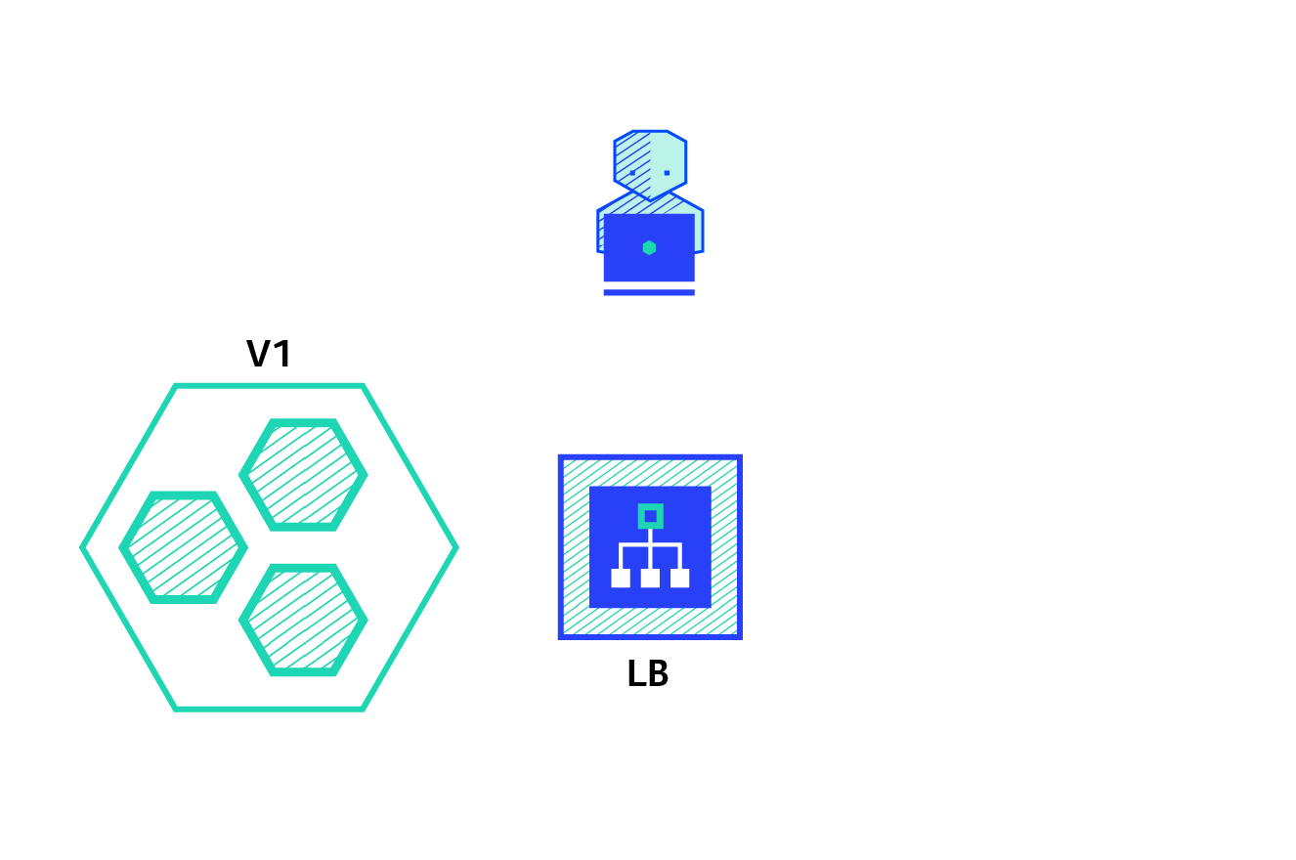
Natively Supported Deployment Strategies
A deployment strategy is a way to change or upgrade an application. The two directly supported Kubernetes deployment strategies are:
Rolling Update - Consists of slowly rolling out a new version of an application by replacing instances one after the old version until all the instances are rolled out. This is the default strategy for Kubernetes Deployments when none is specified.

Slide 15


Natively Supported Deployment Strategies
Recreate - Consists of shutting down all instances of the current version, then deploying the new version. This technique implies downtime of the service that depends on both shutdown and boot duration of the application.

Slide 16
Kubectl (“kube cuttle” or “kube control”)
Kubectl is the official command line utility used to interact with the Kubernetes cluster and its resources.
Common commands include:
  Get – Returns a list of objects. Can get all the details for a specific object in yaml or json format.
    Example: Get a list of Nodes: kubectl get nodes
    Example: Retrieve the YAML definition of a Pod from etcd: kubectl get pod pod-123 –o yaml
  Describe – Displays a detailed description of an object and related information from other objects.
    Example: Show detailed description of a service: kubectl describe service/myservice
  Logs – Displays the stdout log from a container in a Pod:
    Example: kubectl logs pod-123 –c nginx
  Exec – Executes a command in container in a Pod:
    Example: kubectl exec –it pod-123 –c nginx –- bash
Notes:
Kubectl connects to the cluster, converts YAML to JSON and calls API Server, including the required certificates and tokens.

Slide 17
Kubectl Apply and Create Commands
Kubectl has two commands for creating objects in its database: Apply & Create.
Apply creates objects through a declarative syntax.
  Example: Create or update any resource defined in a yaml manifest:
  kubectl apply –f mydep.yaml
  You can edit the manifest file and repeat the apply command to update the object in the cluster.
Create creates objects imperatively.
  Example: Create a Deployment object imperatively using system defaults:
  kubectl create deployment mydep --image=nginx --replicas=2
  Since there’s no yaml file to update and reapply, you can update the object using the Edit command.
  kubectl edit deployment mydep
  You can extract an existing object definition into a yaml file and update it later using the apply command:
  kubectl get deployment mydep -o yaml > mydeployment.yaml
  You can also use create to generate a new yaml file for you, without creating the object in Kubernetes:
  kubectl create deployment mydep2 --image=nginx --dry-run=client -o yaml > mydep2.yaml

Slide 18
Kubectl Imperative Commands
In addition to Create, Kubectl supports other imperative commands to interact with deployments (and other objects) already in the database.
Example: Change the image in a deployment without editing and reapplying the yaml:
  kubectl set image deployment/mydep nginx=nginx:1.18
Example: View the deployment rollout history of a deployment:
kubectl rollout history deployment/mydep
Example: Change the number of replicas of a deployment without editing the yaml:
kubectl scale –-replicas=3 deployment/mydep
Example: Add a label to a deployment without editing the yaml:
kubectl label deployment/mydep newlabel=myvalue
Example: Listen on port 5000 on the local machine and forward to port 6000 on the Pod:
kubectl port-forward mypod 5000:6000
Additional examples for using the Kubectl command can be found on the Kubectl Cheat Sheet.

Slide 19
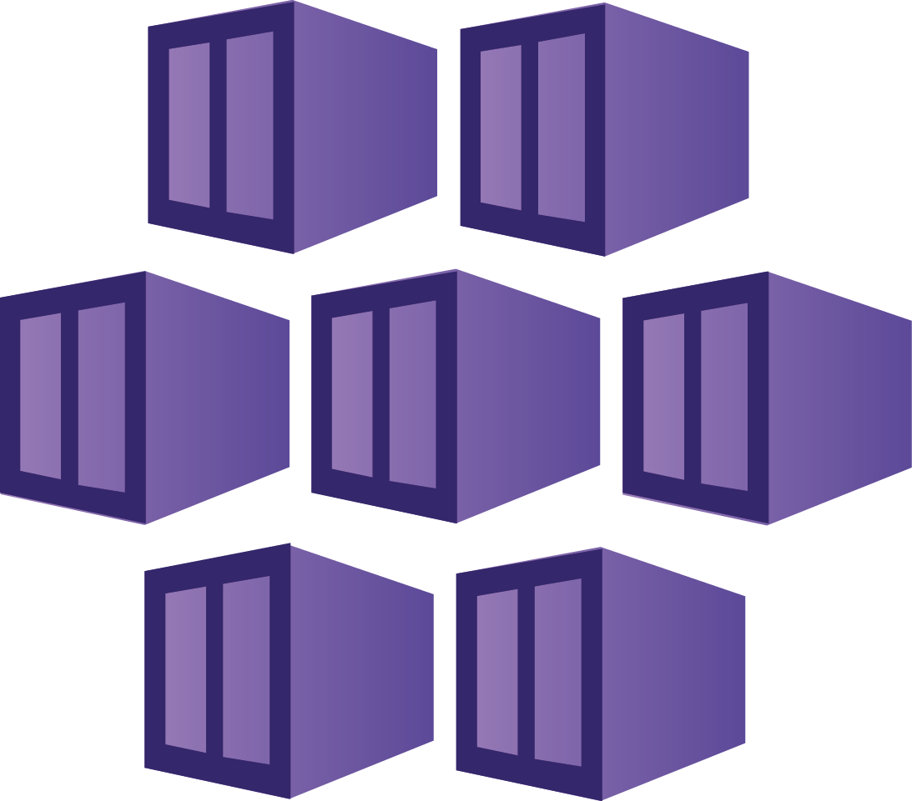
Demo 1
Working with Deployments
Kubectl demo
Notes:
Go over in detail the yaml manifests used in the demo then run the demo script using cluster info
\Demos\Module1\demo-basic-deployments.ps1 or use the bash script with same name under demos_bash\Module1\demo-basic-deployments.sh
Go over kubectl basics with applying files and how to query cluster workloads.
Show how to edit kubectl deployment files live on the cluster to make rapid changes.
How to view objects and different object types and

Slide 20
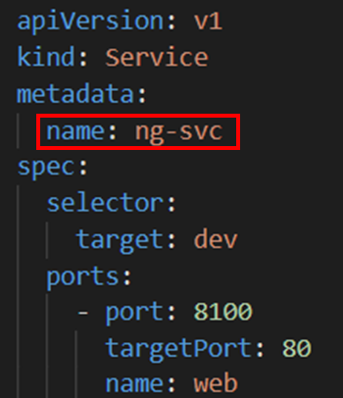
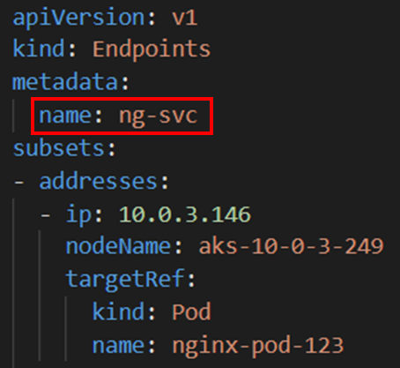
What is a Service?
A Service is an abstraction that defines a logical set of loosely-coupled PODs and a policy by which to access them as a network service.
  Use selectors to define which pods to include.
  Services load balance traffic to Pod replicas (Layer 4)
  Maps external ports to target (container) ports
  Exposes Pods to traffic outside the cluster.
Kubernetes creates an Endpoints object with the same name as the Service.
As Pods are deleted and replaced, the Endpoints object is automatically updated with the new Pods’ IP addresses, as soon as those Pods go into a Ready (Running) state.
This allows the Service’s load balancer to immediately know which Pods it has to choose from when routing incoming traffic.

Slide 21
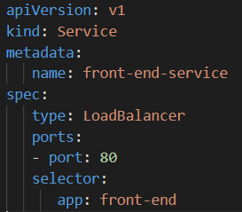
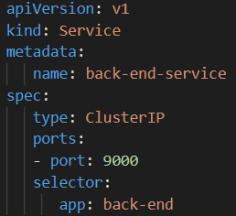
Services at work
You don't need to modify your application to use an unfamiliar service discovery mechanism.
Unlike Pods, Service names/IPs don’t change, so they can be used for reliable routing configurations.
Services Types
  ClusterIP
  NodePort
  LoadBalancer
  ExternalName
front-end-service
back-end-service
Pod1
app: front-end
Pod2
app: front-end
Pod3
app: back-end
Notes:
Mention the 4 types of services. Emphasize the focus here is on ClusterIP and LoadBalancer for the next slides. If needed the other two can be included or just provider a brief overview.

Slide 22
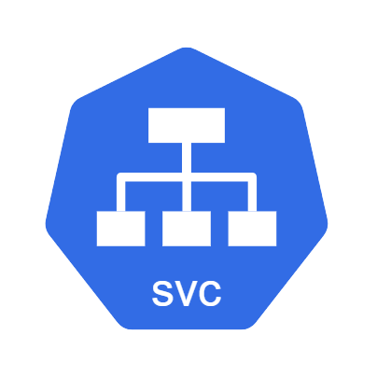
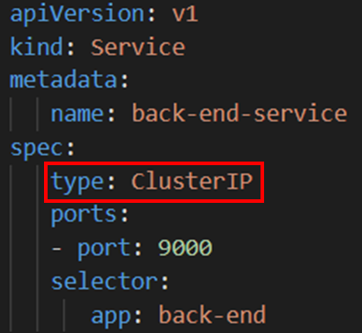

Service Types – ClusterIP
ClusterIP – An internal IP address for use within the Kubernetes cluster.
Used for internal communications between workloads within the cluster.
Default service type when one is not specified.
Traffic
Internal Traffic
Port: 8080
Load Balancer
Target Port: 80

Slide 23
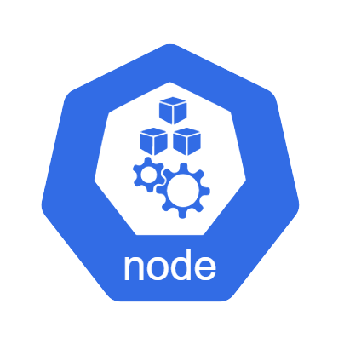
Service Types – NodePort
NodePort - Creates a port mapping to the underlying Node, which allows external access directly to Pods by using the Node IP address (any Node’s IP) and the Node Port.
Used in on-premise Kubernetes clusters to expose services for external access.
Only practical in AKS clusters when the Nodes’ IP addresses are externally accessible, such as for Game Servers. Can be configured during cluster creation using this parameter:
  --enable-node-public-ip
External Traffic
Node Port: 31000
Node IP
Node IP
Port: 8080
Port: 8080
Target Port: 80
Notes:
Node Ports are mostly used in on-premise clusters where the Node IPs are known.

Slide 24
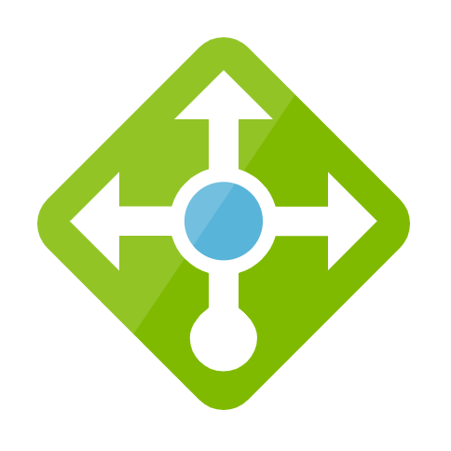
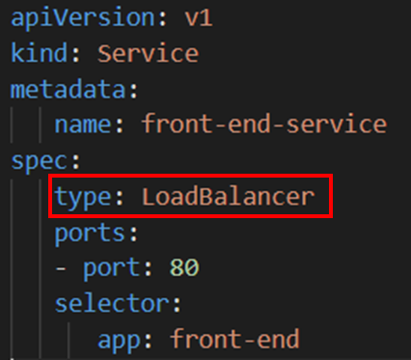
Service Types – LoadBalancer
LoadBalancer – Requests an external IP address (public by default) from the Azure Load Balancer.
Azure creates an IP Address resource and adds it to the load balancer backend pool.
Allow external traffic to reach Pods in the cluster.
Traffic
External IP
Azure Load Balancer
Traffic
Node IP
Service Load Balancer
Notes:
A LoadBalancer service contains a NodePort and ClusterIP configurations. Internal traffic still uses the internal ClusterIP address for access.

Slide 25
Service Types – ExternalName
ExternalName – A special case of Service that does not have selectors, because it’s used for external access.
An ExternalName maps a Service to a DNS name, for Pods to have consistent routes to external resources.
External Service
Traffic

Slide 26

Advanced Deployment Strategies
You can also use advanced deployment strategies by combining multiple deployments and additional networking resources:
Blue/Green – Consists of deploying the new version (green) alongside the current version (blue) with the same number of instances. After testing that the new version meets all the requirements, the traffic is switched from old to new version at the load balancer. This requires using two Kubernetes Deployments and at least one Kubernetes Service.

Slide 27

Advanced Deployment Strategies
Canary – Consists of gradually shifting production traffic from old to new version. Usually, the traffic is split based on weight. While this strategy can be “simulated” using a single Kubernetes Service, it’s often implemented using a 3rd party Ingress Controller.
For more details, review Deployment Strategies on Kubernetes

Slide 28
Demo 2
Services Demo
Advanced Deployments
Notes:
\Demos\Module1\demo-services.ps1
Run the demo script: \Demos\Module1\demo-blue-green-deployments.ps1
Run the demo script: \Demos\Module1\demo-canary-deployments.ps1

Slide 29
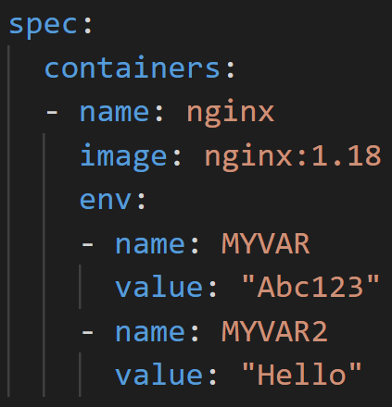
Pod Environment Variables
When working with containers in Docker, you can define environment variables when you create your containers, either individually or by specifying a file:
docker run -e MYVAR1 --env MYVAR2=foo --env-file ./env.list ubuntu
When creating Pods, you can specify environment variables as a list of name/value pairs in the container’s specification.
If you want to use an entire file full of environment variables, you can create a ConfigMap and reference all or part of it in the container’s specification.

Slide 30
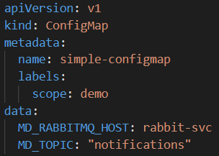
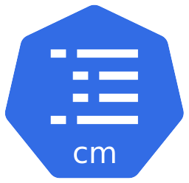
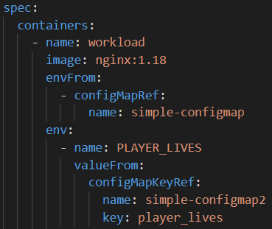
Config Maps
A ConfigMap is used to store non-confidential data as key-value pairs.
They allows you to decouple environment-specific configuration from container instances.
Containers can consume ConfigMaps as environment variables.
Containers can use an entire ConfigMap or only selected values.
ConfigMaps can be referenced by multiple Containers in different Pods.

Slide 31
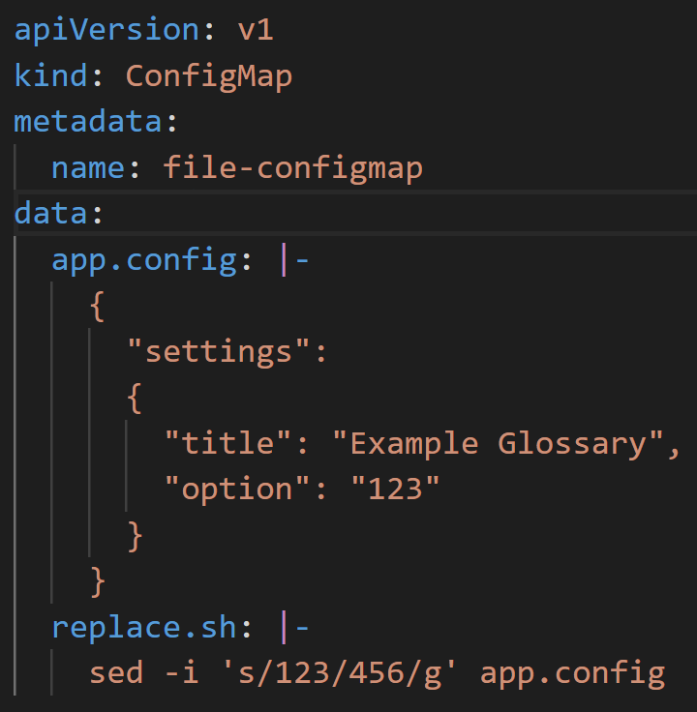
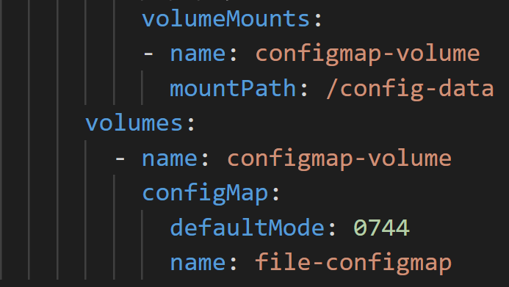
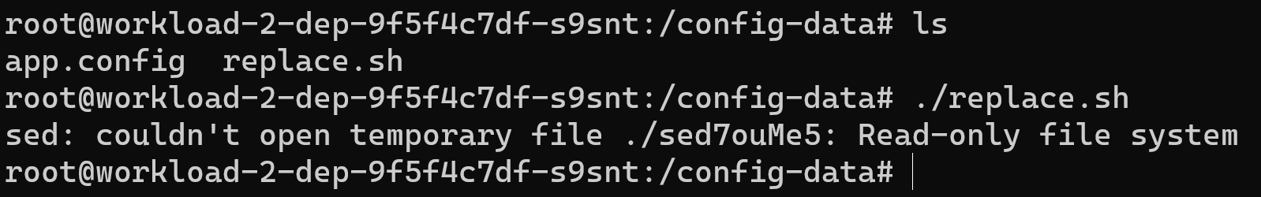
ConfigMaps Mounted as Volumes
ConfigMaps can also contain entire file definitions.
These ConfigMaps can be attached as Volumes in a Pods and mounted as read-only folders in containers.
Each entry in a ConfigMaps is mounted as a separate file.
If scripts are defined in ConfigMaps, they can be automatically mounted with executable permissions, using the defaultMode setting.

Slide 32
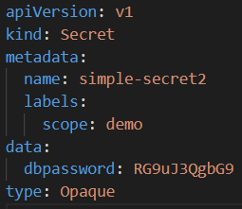

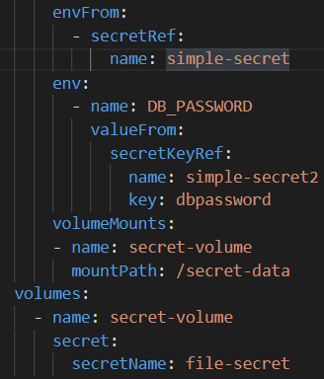
Secrets
Secrets are the same as ConfigMaps, except the data/files they hold is encoded not Encrypted
They can be used to store and manage sensitive information, such as passwords, OAuth tokens, and ssh keys.
Storing confidential information in a Secret is safer and more flexible than setting it verbatim in a Pod definition or in a container image.
Other Kubernetes resources, like Ingresses and Persistent Volumes, also use Secrets as part of their configuration.
How can we protect secrets?

Slide 33
Namespaces
Namespaces be used to logically segment resources by:
  Environments – Ex: Development resources can be in one namespace, Staging in another
  Applications – Ex: Shopping cart microservices in one namespace, Marketing in another
  Developers – Ex: Each developer can have their own, isolated workspace.
    User permissions/resources can be limited by namespace.
To access resources across namespaces, use their FDQN:
  Mysql.connect(“db-service.othernamespace.svc.cluster.local”)
Querying namespaces
    kubectl get namespaces (Gets all namespaces in the cluster)
    kubectl get pods –n mynamespace (Gets all pods in selected namespace)
    Kubectl api-resources (lists all available resources and cluster scoped resources)

Slide 34
Demo 3
Config maps Demo
Secrets Demo
Notes:
Run the demo script: \Demos\Module1\demo-configmaps.ps1
Run the demo script: \Demos\Module1\demo-secrets.ps1

Slide 35
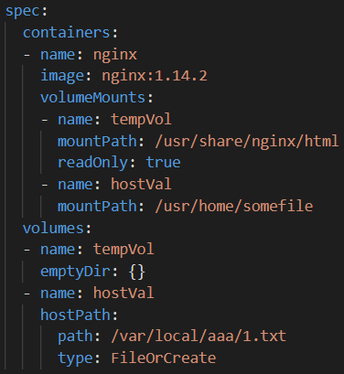
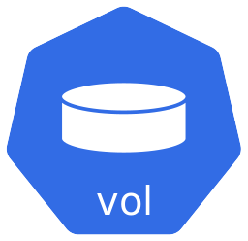
Ephemeral Volumes
Ephemeral volume types have a lifetime of a pod. Ephemeral volumes include:
Empty Dir – A temporary folder for all containers within a Pod to read/write to.
  Host Path – Mounts a file or directory from the host node's filesystem into your Pod. Not practical in a multi-node cluster.
  Config Map/Secret – A Read-only folder that provides a way to inject configuration data into pods.

Slide 36
Persistent Volumes
Persistent volumes exist beyond the lifetime of a pod. Persistent volumes include:
  Persistent Volume Claim - A way for users to "claim" durable storage without knowing the details of the cloud environment.
  A PersistentVolume (PV) resource is a piece of storage in the cluster that has been provisioned by an administrator or dynamically provisioned using Storage Classes
There are two ways PVs may be provisioned:
  Statically - A cluster administrator creates multiple PVs that carry the details of the real storage, which is available for use by cluster users.
  Dynamically - When none of the available static PVs match a user's Persistent Volume Claim, the cluster will try to dynamically provision a volume specially for the PVC, based on a specified Storage Classes.
Notes:
No deep dives into Azure storage types here. This is covered in the AKS Storage module. Keep it high level and Kubernetes concepts only.
PVs are volume plugins like Volumes but have a lifecycle independent of any individual Pod that uses the PV.
It is a cluster wide resource (not namespaced), available to for any user to claim.

Slide 37
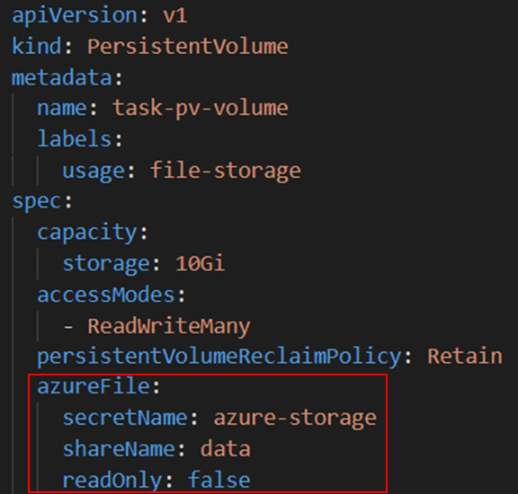
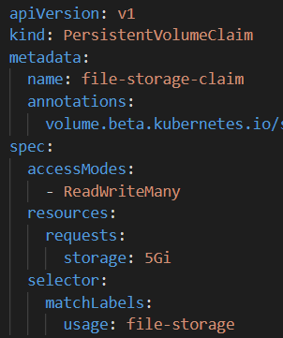
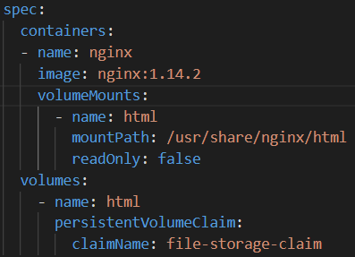
Static Persistent Volume Claims
Once a PersistentVolume has been created, it can be claimed by a PersistentVolumeClaim. The PVC can then be mounted as a volume in the Pod.
This is an example of a Statically provisioned PersistentVolumeClaim.

Slide 38
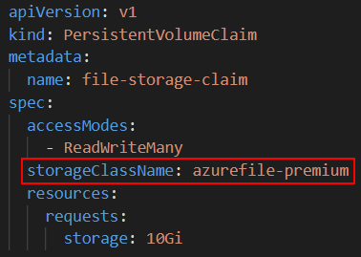
Dynamic Persistent Volume Claims
A PersistentVolumeClaim can also be provisioned dynamically by specifying the StorageClass (wrapper around driver) to use when creating the PVC.
A storage account is automatically created in the infrastructure resource group for use with the storage class to hold the Azure file shares.
NOTE: If the cluster is deleted (like cattle), all the resources in the infrastructure resource group, including dynamically provisioned file shares and disks, will also be deleted.

Slide 39
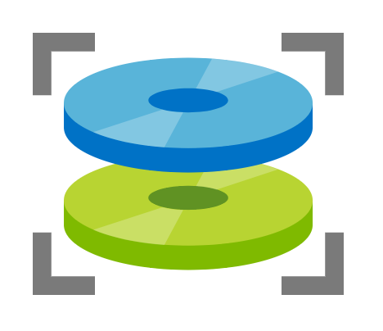
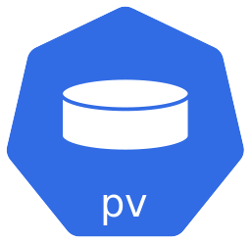
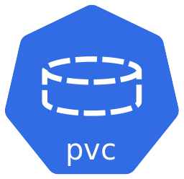


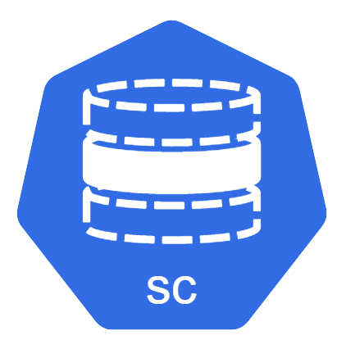


Overview of Kubernetes Volumes
Kubernetes offers many flexible options for mounting volumes into Pods.
Cluster
Namespace
Node
Pod
Azure Disk
Volumes
Host Path
Containers
Azure File Share
Empty Dir

Slide 40
Demo
Working with Volumes
Advanced Volumes

Slide 41
Health Checks
How do you know if a container has completed its start up sequence and is ready to accept requests?
What if a container is “running” but not functioning correctly?
  For example, a webserver not receiving/processing requests
Kubelet uses probes to monitor running containers and determine if they’re running and/or can receive traffic from services.
Based on information it receives from probes, a Kubelet can restart containers or notify Kube-proxy to update its Endpoints and take Pods out of a service’s load balancer rotation.

Slide 42
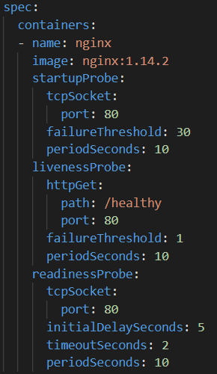
Startup, Liveness and Readiness Probes
There are three different types of probes available to attach to containers:
  Startup Probe – Detects when an application has started. Some applications, like messaging servers, have extended startup sequences. Startup probes delay other probes from inadvertently telling the Kubelet restart the container for being unresponsive.
  Liveness Probe – Once the application has started, a liveness probe monitors it periodically to ensure it’s still running and tell the Kubelet to restart the container if it doesn’t get a response.
  Readiness Probe – Applications which service external requests, through a Service, can be monitored to ensure they are still receiving those requests. When they stop receiving requests, Readiness Probes can tell the Kubelet to exclude those pods from the service’s load balancer rotation.

Slide 43
Demo
Health Probes Demo
Notes:
Run the demo script: \Demos\Module3\demo-probes.ps1

Slide 44

Kubernetes Load Balancer vs Ingress
A Kubernetes Load Balancer maps an external IP to a single service endpoint inside the cluster.
Each Kubernetes Load Balancer service requests an external IP address from Azure.
For multiple service endpoints, you need to create multiple Load Balancers and IPs.
If you expose dozens or hundreds of endpoints, this approach doesn’t scale well.
Cluster
External IP
NodePort 31300
External IP
NodePort 31400
External IP
NodePort 31500

Slide 45
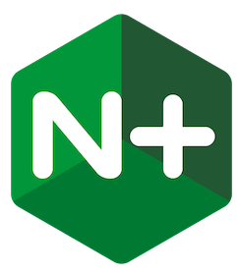
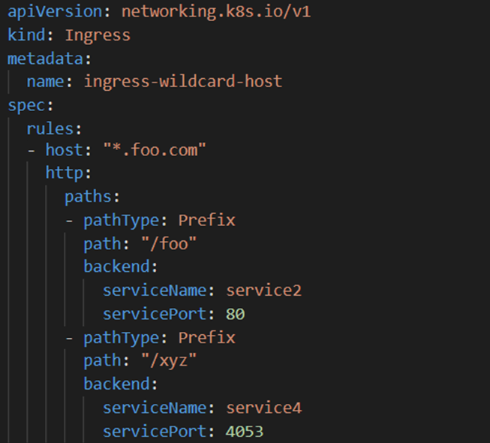
Kubernetes Load Balancer vs Ingress
An Ingress Resource enables routing to internal traffic through a single external endpoint.
Cluster
Rule
External IP
NodePort 31400
Rule
Rule
Routing rules are defined in Ingresses in each namespace.
A single Ingress Controller combines Ingress rules across all namespaces and routes external HTTP and HTTPS (layer 7 only) traffic to internal Cluster IP services.
Kubernetes does not provide a concrete implementation of an Ingress Controller to perform this routing.

Slide 46
3rd Party Ingress Controller
To support Ingress resources, you must install a 3rd party Ingress Controller.
Kubernetes supports the following popular Ingress Controllers:
  The NGINX Ingress Controller for Kubernetes works with the NGINX webserver (as a proxy).
  The Traefik Kubernetes Ingress provider is an ingress controller for the Traefik proxy.
  The AKS Application Gateway Ingress Controller is an ingress controller that configures the Azure Application Gateway.

Slide 47
Demo
Ingress Controller Demo
Notes:
Run the demo script: \Demos\Kubernetes_fundamentals_demos\demo-ingress.ps1

Slide 48
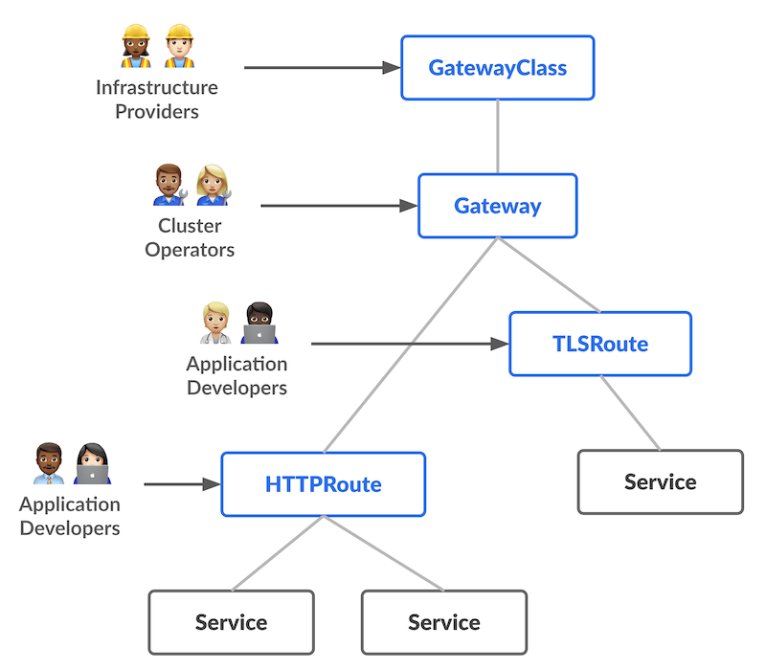
What is Gateway API?
Next gen of Kubernetes Ingress, Load Balancing, and Service Mesh APIs
Generic, Expressive, Role Oriented
Gateway API for Ingress
Gateway API for Service Mesh
Notes:
Gateway API is an official Kubernetes project focused on L4 and L7 routing in Kubernetes. This project represents the next generation of Kubernetes Ingress, Load Balancing, and Service Mesh APIs. From the outset, it has been designed to be generic, expressive, and role-oriented.
The overall resource model focuses on 3 separate personas and corresponding resources that they are expected to manage:
Most of the configuration in this API is contained in the Routing layer. These protocol-specific resources (HTTPRoute, GRPCRoute, etc) enable advanced routing capabilities for both Ingress and Mesh.
The Gateway API Logo helps illustrate the dual purpose of this API, enabling routing for both North-South (Ingress) and East-West (Mesh) traffic to share the same configuration.

Slide 49
Gateway API Concepts
Design Goals
  Role-oriented
  Portable
  Expressive
  Extensible
Capabilities
  GatewayClasses
  Share Gateways and Cross- Namespace Support
  Type Routes and typed backends
  Experimental Service Mesh support via GAMMA Initiative
Notes:
Role-oriented - Gateway is composed of API resources which model organizational roles that use and configure Kubernetes service networking.
Why does a role-oriented API matter?¶
Whether it’s roads, power, data centers, or Kubernetes clusters, infrastructure is built to be shared. However, shared infrastructure raises a common challenge - how to provide flexibility to users of the infrastructure while maintaining control by owners of the infrastructure?
Gateway API accomplishes this through a role-oriented design for Kubernetes service networking that strikes a balance between distributed flexibility and centralized control. It allows shared network infrastructure (hardware load balancers, cloud networking, cluster-hosted proxies etc) to be used by many different and non-coordinating teams, all bound by the policies and constraints set by cluster operators.
Portable - This isn't an improvement but rather something that should stay the same. Just as Ingress is a universal specification with numerous implementations, Gateway API is designed to be a portable specification supported by many implementations.
Expressive - Gateway API resources support core functionality for things like header-based matching, traffic weighting, and other capabilities that were only possible in Ingress through custom annotations.
Extensible - Gateway API allows for custom resources to be linked at various layers of the API. This makes granular customization possible at the appropriate places within the API structure.
GatewayClasses - GatewayClasses formalize types of load balancing implementations. These classes make it easy and explicit for users to understand what kind of capabilities are available via the Kubernetes resource model.
Shared Gateways and cross-Namespace support - They allow the sharing of load balancers and VIPs by permitting independent Route resources to attach to the same Gateway. This allows teams (even across Namespaces) to share infrastructure safely without direct coordination.
Typed Routes and typed backends - Gateway API supports typed Route resources and also different types of backends. This allows the API to be flexible in supporting various protocols (like HTTP and gRPC) and various backend targets (like Kubernetes Services, storage buckets, or functions).
Experimental Service mesh support with the GAMMA initiative - Gateway API supports associating routing resources with Service resources, to configure service meshes as well as ingress controllers.
Gateway API for Mesh Management and Administration to define how Gateway API could also be used for inter-service or east/west traffic within the same cluster.

Slide 50
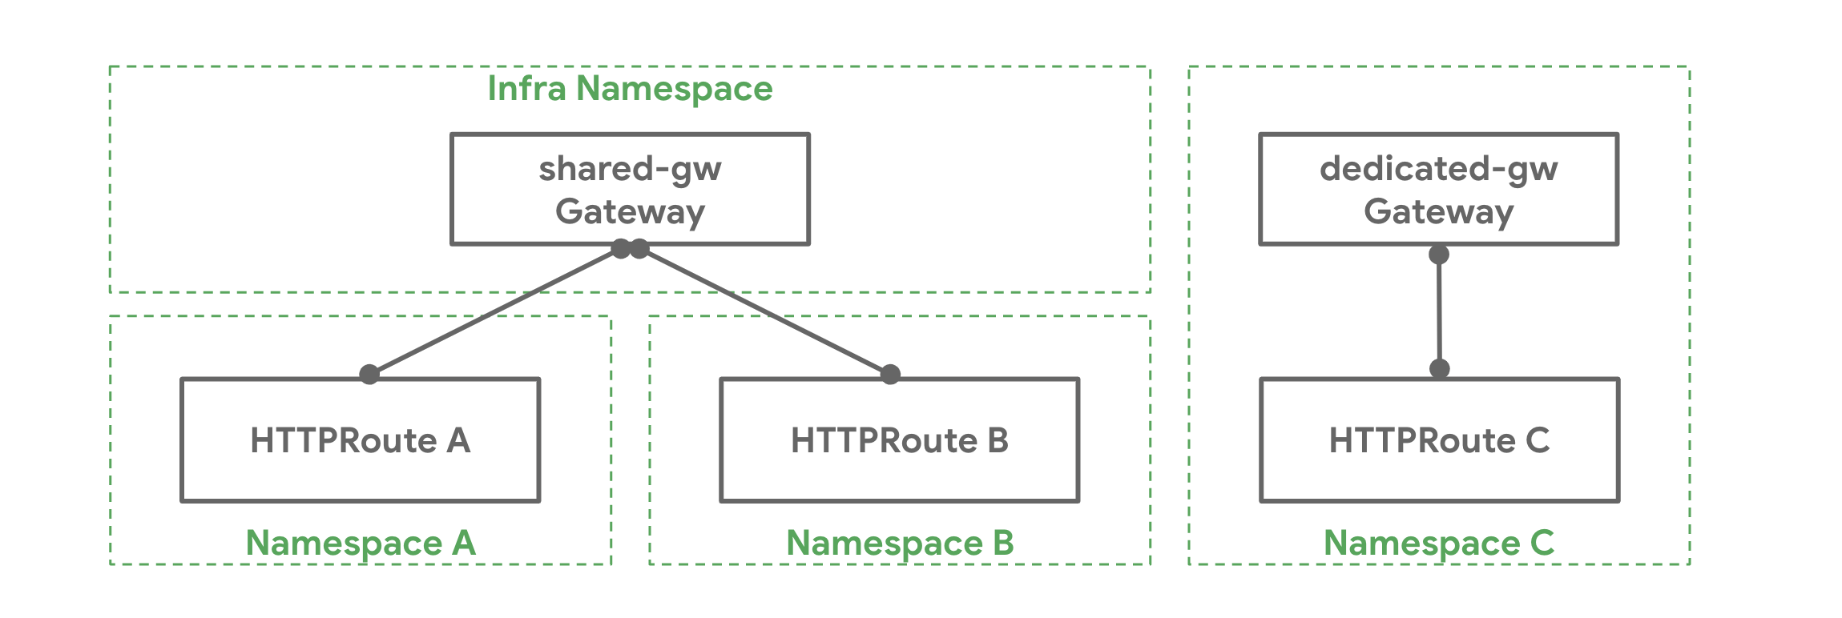
Gateway API Concepts
Gateways
  Describe
  how traffic is translated to services in the cluster
Routes
  HTTPRoute
  TLSRoute
  TCPRoute / UDPRoute
  GRPCRoute
Gateway to Routes
  One to One
  One to Many
  Many to One
Notes:
Gateway¶
Standard Channel in v0.5.0+
A Gateway describes how traffic can be translated to Services within the cluster. That is, it defines a request for a way to translate traffic from somewhere that does not know about Kubernetes to somewhere that does. For example, traffic sent to a Kubernetes Service by a cloud load balancer, an in-cluster proxy, or an external hardware load balancer. While many use cases have client traffic originating “outside” the cluster, this is not a requirement.
It defines a request for a specific load balancer config that implements the GatewayClass’ configuration and behaviour contract. The resource may be created by an operator directly, or may be created by a controller handling a GatewayClass.
As the Gateway spec captures user intent, it may not contain a complete specification for all attributes in the spec. For example, the user may omit fields such as addresses, TLS settings. This allows the controller managing the GatewayClass to provide these settings for the user, resulting in a more portable spec. This behaviour will be made clear using the GatewayClass Status object.
A Gateway may be attached to one or more Route references which serve to direct traffic for a subset of traffic to a specific service.
Route Resources¶
Route resources define protocol-specific rules for mapping requests from a Gateway to Kubernetes Services.
As of v1alpha2, four Route resource types are included with the API. Custom Route types that are implementation-specific are encouraged for other protocols. New route types may be added to the API in future.
HTTPRoute¶
Standard Channel in v0.5.0+
HTTPRoute is for multiplexing HTTP or terminated HTTPS connections. It's intended for use in cases where you want to inspect the HTTP stream and use HTTP request data for either routing or modification, for example using HTTP Headers for routing, or modifying them in-flight.
TLSRoute¶
Experimental Channel in v0.3.0+
TLSRoute is for multiplexing TLS connections, discriminated via SNI. It's intended for where you want to use the SNI as the main routing method, and are not interested in properties of the higher-level protocols like HTTP. The byte stream of the connection is proxied without any inspection to the backend.
TCPRoute and UDPRoute¶
Experimental Channel in v0.3.0+
TCPRoute (and UDPRoute) are intended for use for mapping one or more ports to a single backend. In this case, there is no discriminator you can use to choose different backends on the same port, so each TCPRoute really needs a different port on the listener (in general, anyway). You can terminate TLS in which case the unencrypted byte stream is passed through to the backend. You can choose to not terminate TLS, in which case the encrypted byte stream is passed through to the backend.
GRPCRoute¶
Experimental Channel in v0.6.0+
GRPCRoute is for idiomatically routing gRPC traffic. Gateways supporting GRPCRoute are required to support HTTP/2 without an initial upgrade from HTTP/1, so gRPC traffic is guaranteed to flow properly.
Attaching Routes to Gateways¶
When a Route attaches to a Gateway, it represents configuration that is applied on the Gateway that configures the underlying load balancer or proxy. How and which Routes attach to Gateways is controlled by the resources themselves. Route and Gateway resources have built-in controls to permit or constrain how they are attached. Together with Kubernetes RBAC, these allow organizations to enforce policies for how Routes are exposed and on which Gateways.
There is a lot of flexibility in how Routes can attach to Gateways to achieve different organizational policies and scopes of responsibility. These are different relationships that Gateways and Routes can have:
One-to-one - A Gateway and Route may be deployed and used by a single owner and have a one-to-one relationship.
One-to-many - A Gateway can have many Routes bound to it that are owned by different teams from across different Namespaces.
Many-to-one - Routes can also be bound to more than one Gateway, allowing a single Route to control application exposure simultaneously across different IPs, load balancers, or networks.

Slide 51
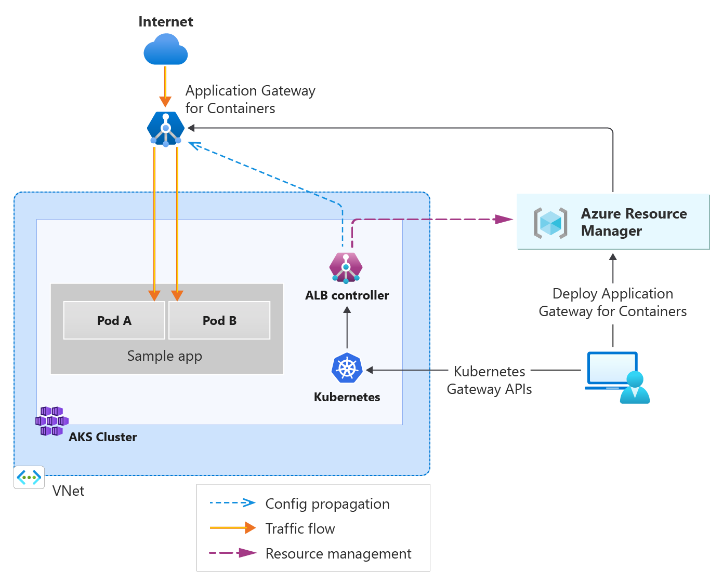
Application Gateway for Containers
Application Load balancing and traffic management
Exists under App gateway
3 Components
  Application Gateway for containers
  Frontends
  Associations
Features
  Traffic splitting/ Weighted round robin
  Mutual Auth to backend target
  K8s support for Ingress and Gateway API
Notes:
Features and Benefits
Application Gateway for Containers offers some entirely new features at release, such as:
Traffic splitting / Weighted round robin
Mutual authentication to the backend target
Kubernetes support for Ingress and Gateway API
Flexible deployment strategies
Increased performance, offering near real-time updates to add or move pods, routes, and probes
Application Gateway for Containers offers an elastic and scalable ingress to AKS clusters and comprises a new data plane as well as control plane with new set of ARM APIs, different from existing Application Gateway. These APIs are different from the current implementation of Application Gateway. Application Gateway for Containers is outside the AKS cluster data plane and is responsible for ingress. The service is managed by an ALB controller component that runs inside the AKS cluster and adheres to Kubernetes Gateway APIs.
Deployment strategies
There are two deployment strategies for management of Application Gateway for Containers:
Bring your own (BYO) deployment: In this deployment strategy, deployment and lifecycle of the Application Gateway for Containers resource, Association, and Frontend resource is assumed via Azure portal, CLI, PowerShell, Terraform, etc. and referenced in configuration within Kubernetes.
In Gateway API: Every time you wish to create a new Gateway resource in Kubernetes, a Frontend resource should be provisioned in Azure prior and referenced by the Gateway resource. Deletion of the Frontend resource is responsible by the Azure administrator and isn't deleted when the Gateway resource in Kubernetes is deleted.
Managed by ALB Controller: In this deployment strategy ALB Controller deployed in Kubernetes is responsible for the lifecycle of the Application Gateway for Containers resource and its sub resources. ALB Controller creates Application Gateway for Containers resource when an ApplicationLoadBalancer custom resource is defined on the cluster and its lifecycle is based on the lifecycle of the custom resource.
In Gateway API: Every time a Gateway resource is created referencing the ApplicationLoadBalancer resource, ALB Controller provisions a new Frontend resource and manage its lifecycle based on the lifecycle of the Gateway resource.

Slide 52
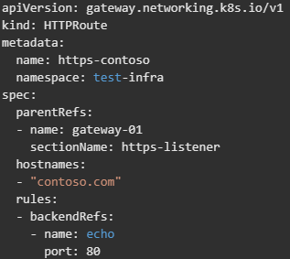
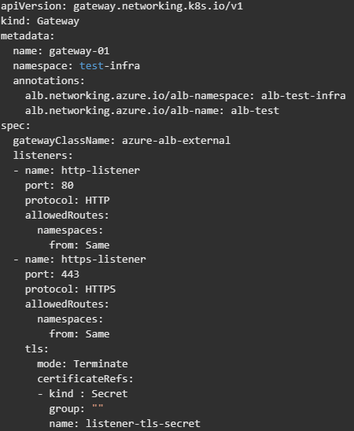
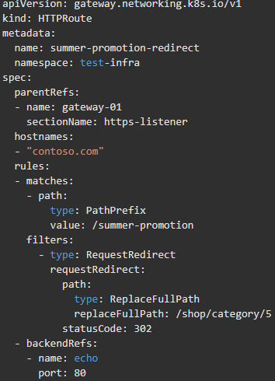
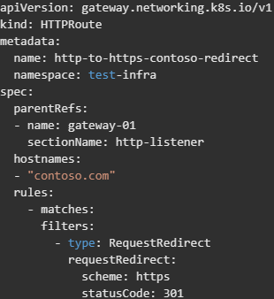
Gateway API Concepts - Examples
Notes:
Role-oriented - Gateway is composed of API resources which model organizational roles that use and configure Kubernetes service networking.
Why does a role-oriented API matter?¶
Whether it’s roads, power, data centers, or Kubernetes clusters, infrastructure is built to be shared. However, shared infrastructure raises a common challenge - how to provide flexibility to users of the infrastructure while maintaining control by owners of the infrastructure?
Gateway API accomplishes this through a role-oriented design for Kubernetes service networking that strikes a balance between distributed flexibility and centralized control. It allows shared network infrastructure (hardware load balancers, cloud networking, cluster-hosted proxies etc) to be used by many different and non-coordinating teams, all bound by the policies and constraints set by cluster operators.
Portable - This isn't an improvement but rather something that should stay the same. Just as Ingress is a universal specification with numerous implementations, Gateway API is designed to be a portable specification supported by many implementations.
Expressive - Gateway API resources support core functionality for things like header-based matching, traffic weighting, and other capabilities that were only possible in Ingress through custom annotations.
Extensible - Gateway API allows for custom resources to be linked at various layers of the API. This makes granular customization possible at the appropriate places within the API structure.
GatewayClasses - GatewayClasses formalize types of load balancing implementations. These classes make it easy and explicit for users to understand what kind of capabilities are available via the Kubernetes resource model.
Shared Gateways and cross-Namespace support - They allow the sharing of load balancers and VIPs by permitting independent Route resources to attach to the same Gateway. This allows teams (even across Namespaces) to share infrastructure safely without direct coordination.
Typed Routes and typed backends - Gateway API supports typed Route resources and also different types of backends. This allows the API to be flexible in supporting various protocols (like HTTP and gRPC) and various backend targets (like Kubernetes Services, storage buckets, or functions).
Experimental Service mesh support with the GAMMA initiative - Gateway API supports associating routing resources with Service resources, to configure service meshes as well as ingress controllers.
Gateway API for Mesh Management and Administration to define how Gateway API could also be used for inter-service or east/west traffic within the same cluster.

Slide 53
Demo
Gateway API on AGC
Notes:
Optional Demo using Application Gateway for containers
This demo is more involved so make sure to set this up beforehand.
Demo setup:
1. Quickstart: Deploy Application Gateway for Containers ALB Controller | Microsoft Learn
2. Quickstart: Create Application Gateway for Containers managed by ALB Controller | Microsoft Learn
3. Traffic Splitting with Application Gateway for Containers - Gateway API | Microsoft Learn

Slide 54
Questions?
Notes:
After taking questions move onto part 2
Lab is at the end of part 2

